Slide 1
Abe No Nakamaro
Ambassador of Sino-Japanese Cultural Exchange to Present Diplomatic Relations

Slide 2
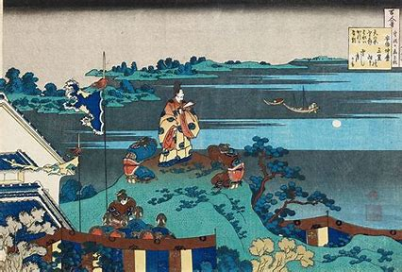
Abe no NakaNaro
Japanese scholar
Waka poet of the Nara period
Japanese envoy to Tang China
Became the Tang duhu (protectorate governor) of Annan (modern Vietnam).
Close friend Chinese poets Li Bai and Wang Wei, Zhao Hua, Bao Xin, and Chu Guangxi.

Slide 3
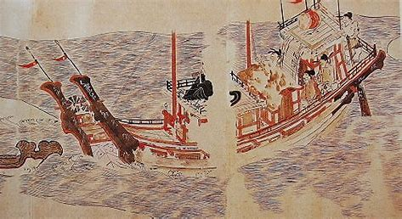
long-standing cultural exchange
The diplomatic relations between Tang and Japan included exchanges of culture, art, music, technology, and language.
Language: Before 5th century AD, Japan had only language but no script. The Chinese characters laid the foundation for the later Japanese kana characters.
Culture: Japanese daily life, tea, noodles,
dumplings, Japanese tofu, etc. are all taught
by monks. During the Nara period, Chinese
music and dance "Sanle" and Japanese
traditional dance were combined to form
"Noh".
Technology: Han brought silkworm-raising
techniques from China. Excellent sericulture
technology and advanced silk loom
improvement technology brought Japan’s
silk industry to a new level.

Slide 4
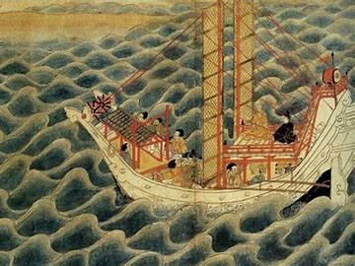
The heyday of cultural exchanges between the two countries
In the early Tang Dynasty, Japan sent envoys to Tang Dynasty on the basis of sending envoys to Sui Dynasty , to find a way for the development of Japanese society.
They are mainly engaged in activities to absorb the excellent culture of the Tang Dynasty.
$→$Visit Confucian temples and other cultural attractions
$→$Hire various talents
$→$Teach Confucian classics.

Slide 5
The influence of militarism
In 1543, a Portuguese ship drifted in the
southern part of Kyushu.
After the Meiji Restoration, Japanese culture entered the system of fascist aggression culture. Gradually, as Japan's national strength developed, militarism turned evil.
WW2 Japan
$→$Started a 14-year war against China.
$→Des$troyed and plundered Chinese cultural relics, culture and education
$→Caused$ many deaths(c. 20 million)

Slide 6
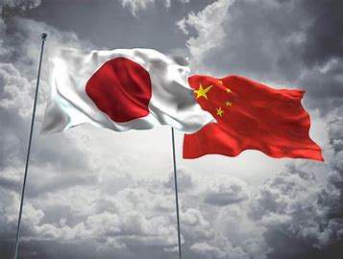
Current Relationship
At present, China-Japan friendship has improved.
With a correct understanding of the past
history and facing the future, will promote
development of relations, through people-to-people exchanges, through mutual understanding, to create a new Sino-Japanese relationship.
The long-term pursuit is to promote mutual understanding, trust and friendship between China and Japan, and to make the greatest efforts toward generational friendship.

Slide 7
Thank you
By Aurelius Wang，Sam He and Owen Hui

